Slide 1
CodeX Mission Reminders

Slide 2
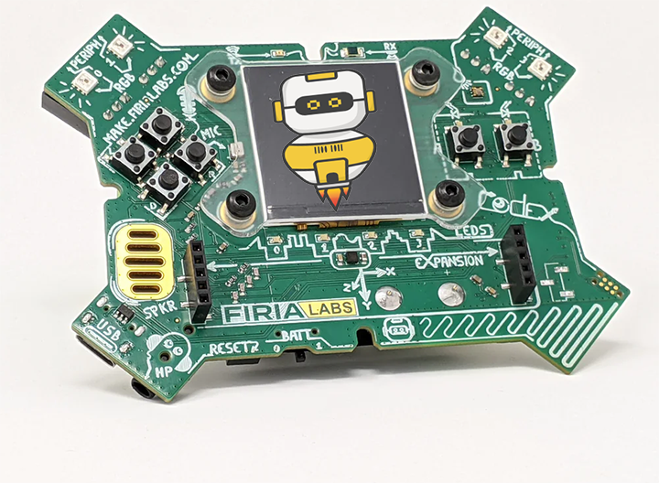
Reminders when working on a new mission:
Always start a new program by creating a new file
Always use a descriptive name

Slide 3
Reminders when working on a new mission:
You are working on a project – not completing a worksheet, so….
Seek to understand the new concepts and the “why” for coding instructions
Focus on the project
Avoid rushing through the material – take your time
Test your understanding along the way by trying stuff – see what happens

Slide 4
Reminders when working on a new mission:
Collect all the tools you find! (look for the wrench icon)
Pay attention to new terms – they are used frequently
Don’t just skip over something you understand – get help!
Read ALL the instructions carefully – don’t skip to the code without reading and understanding

